Slide 1

The Cortana Intelligence Suite
DevOps for Data Science
Microsoft Artificial Intelligence and Research Team
Learnanalytics.microsfoft.com
Notes:
Description:
DevOps (Developer Operations) is defined as a development process that emphasizes communication and collaboration between product management, software development, and operations, automating the process of solution integration, testing, deployment and infrastructure changes.
All projects involving on-premises software and hardware benefits from DevOps. But hybrid and cloud-only architectures require it – there are so many variables to even setting up the architecture that a dedicated team or developer is often required. And Advanced Analytics projects involving Data Science have even more requirements that are specific to these tasks.
This course explains the processes, procedures, platform options that you have available, along with explaining the tools you need to use to create an effective DevOps solution for your Advanced Analytics projects.
Level:
300
Audience:
Technical professionals tasked with the infrastructure and development of a DevOps practice for Advanced Analytics Projects.

Slide 2
Welcome!
Log in to the site:
http://cisw-foundations.azurewebsites.net/
Select the “DEV001 – DevOps for Data Science” Link

Slide 3



Lab:
Optional: Local Workstation Setup
Notes:
Optional, if using your local Windows machine (the Data Science Virtual Machine located in later labs already has these items installed):
Install Visual Studio 2017 Community Edition and select the “Data Science” workload: https://www.visualstudio.com/vs/community/
Install Power BI Desktop: https://powerbi.microsoft.com/en-us/desktop/
Install the Azure SDK: https://www.visualstudio.com/downloads/
Install Azure PowerShell: https://www.microsoft.com/web/handlers/webpi.ashx/getinstaller/WindowsAzurePowershellGet.3f.3f.3fnew.appids
Install Azure CLI: https://docs.microsoft.com/en-us/cli/azure/install-azure-cli
Install AZ Copy: https://aka.ms/downloadazcopy and add it to your PATH variable in Windows
Open Visual Studio, add in Extensions and Updates for the Azure Cloud Explorer, the Azure Data Factory, Azure HDInsight and other CIS platform Extensions as instructed.

Slide 4
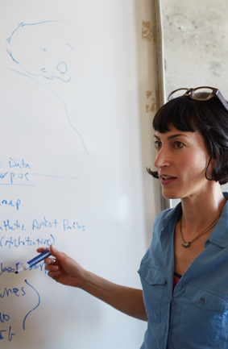
Learning Objectives
Plan for an Advanced Analytics solution using a prescribed process
Understand platform component options
Understand and implement Developer Operations (DevOps) processes and Functions
Understand and implement the tools required for setting up, managing, coding and delivering a Data Science project
Notes:
Course Objectives - At the end of this Module, you will:
Plan for an Advanced Analytics solution using a prescribed process
Understand platform component options
Understand and implement Developer Operations (DevOps) processes and Functions
Understand and implement the tools required for setting up, managing, coding and delivering a Data Science project

Slide 5

Class
Self-Study
Projects
Notes:
There’s a lot of information here. You’ll get hands-on experience in class, with a chance to ask an instructor any questions you might have. However, this forms only a small part of learning so many technologies and processes.
The next largest section of your learning is to read each and every reference in the student handouts. Many point to books, websites and entire courses you can take in each topic. You won’t be expected to learn all of them at once – it’s more common to pull out the sections you need when you do a project, and learn about that technology before you implement it.
You’ll learn the most by actually creating and implementing solutions for your customers. You will do a quick design during this course, but that is a small sample of working with the technologies in a hands-on fashion. The good news is that you’ll find everything you need to be successful in this course and these materials.

Slide 6
Advanced Analytics
Notes:
In order to understand DevOps on Advanced Analytics, we need to understand that AA combines multiple disciplines - https://www.microsoft.com/en-us/cloud-platform/advanced-analytics

Slide 7
Advanced Analytics
Advanced Analytics
Data Fundamentals
Data Science
Machine Learning
Artificial Intelligence
Deep Learning
Data Storage and Processing
Reporting
Business Intelligence
Data Query
Notes:
The first thing to know is that organizations do not always consider a “Data Science” or AI project as a separate entity – they view it as a continuum in their data-as-asset strategy.
SQL Server - https://www.microsoft.com/en-us/sql-server/default.aspx
Reporting Services - https://docs.microsoft.com/en-us/sql/reporting-services/create-deploy-and-manage-mobile-and-paginated-reports
Writing T-SQL Statements - https://docs.microsoft.com/en-us/sql/t-sql/tutorial-writing-transact-sql-statements
SQL Server and Azure Analysis Services - https://docs.microsoft.com/en-us/azure/analysis-services/analysis-services-overview
Data Science Track - https://academy.microsoft.com/en-us/professional-program/data-science/
Microsoft Machine Learning - https://azure.microsoft.com/en-us/services/machine-learning/
Artificial Intelligence and Cognitive Services at Microsoft - https://www.microsoft.com/en-us/ai
Microsoft Deep Learning - https://www.microsoft.com/en-us/research/group/deep-learning-group/

Slide 8
The Team Data Science Process
Business Understanding
Define Objectives
Identify Data Sources
Data Acquisition and Understanding
Ingest Data
Explore Data
Modeling
Feature Selection
Create and Train Model
Deployment
Customer Acceptance
Operationalize
Testing and Validation
Update Data
Handoff
Re-train and re-score
Notes:
It also references the Cortana Intelligence process - https://azure.microsoft.com/en-us/documentation/articles/data-science-process-overview/
A complete process diagram is here - https://azure.microsoft.com/en-us/documentation/learning-paths/cortana-analytics-process/
Some walk-throughs of the various services - https://azure.microsoft.com/en-us/documentation/articles/data-science-process-walkthroughs/
An integrated process and toolset allows for a more close-to-intent deployment
Iterations are required to close in on the solution – but are harder to manage and monitor
Data Science Blog - https://buckwoody.wordpress.com/

Slide 9
The Azure Platform For Advanced Analytics
Big Data
Intelligence and Advanced Analytics
Information Management
Solutions
Visualization
Data Catalog
Data Factory
Event Hubs
Data Lake
SQL Data Warehouse
Cosmos DB
Cortana, Bot Service, Cognitive Framework
HDInsight
Data Lake
Azure Storage
Stream Analytics
Analysis Services
Power BI
R
Templates and Gallery
Machine Learning
Notes:
Azure Data Catalog - http://azure.microsoft.com/en-us/services/data-catalog (Doc It)
Azure Data Factory - http://azure.microsoft.com/en-us/services/data-factory/ (Move It)
Azure Event Hubs - http://azure.microsoft.com/en-us/services/event-hubs/ (Bring It)
Platform and Storage - Microsoft Azure – http://microsoftazure.com Storage - https://azure.microsoft.com/en-us/documentation/services/storage/ (Host It)
Azure Data Lake - http://azure.microsoft.com/en-us/campaigns/data-lake/ (Store It)
Azure SQL Data Warehouse - http://azure.microsoft.com/en-us/services/sql-data-warehouse/ (Relate It)
Azure Cosmos DB - https://docs.microsoft.com/en-us/azure/cosmos-db/introduction
Cortana - http://blogs.windows.com/buildingapps/2014/09/23/cortana-integration-and-speech-recognition-new-code-samples/ and https://blogs.windows.com/buildingapps/2015/08/25/using-cortana-to-interact-with-your-customers-10-by-10/ and https://developer.microsoft.com/en-us/Cortana (Say It)
Cognitive Services - https://www.microsoft.com/cognitive-services
Bot Framework - https://dev.botframework.com/
Azure Machine Learning - http://azure.microsoft.com/en-us/services/machine-learning/ (Learn It)
Azure HDInsight - http://azure.microsoft.com/en-us/services/hdinsight/ (Scale It)
Azure Stream Analytics - http://azure.microsoft.com/en-us/services/stream-analytics/ (Stream It)
Analysis Services - https://docs.microsoft.com/en-us/azure/analysis-services/analysis-services-overview
Power BI - https://powerbi.microsoft.com/ (See It)
All of the components within the suite - https://www.microsoft.com/en-us/server-cloud/cortana-intelligence-suite/what-is-cortana-intelligence.aspx
Templates - https://gallery.cortanaintelligence.com/browse?orderby=freshness%20desc&skip=0&categories=%5B%2210%22%5D and https://caqs.azure.net/#gallery

Slide 10
DevOps Processes
Notes:
Complete DevOps guide - https://docsmsftpdfs.blob.core.windows.net/guides/azure/azure-ops-guide.pdf
Azure Design Patterns: https://blogs.msdn.microsoft.com/uk_faculty_connection/2017/05/17/getting-started-with-azure-design-patterns-and-azure-arm-quick-start-templates/
Deployment
Service Creation and Setup - https://azure.microsoft.com/en-us/offers/ms-azr-0003p/
Cost Management (Pricing) - https://azure.microsoft.com/en-us/pricing/
Migrations - https://msdn.microsoft.com/en-us/library/dn727097.aspx
Tools
The Azure Portal - https://docs.microsoft.com/en-us/azure/azure-portal-overview
PowerShell - https://docs.microsoft.com/en-us/powershell/azure/overview?view=azurermps-3.8.0
CLI - https://docs.microsoft.com/en-us/cli/azure/install-azure-cli
Others - Visual Studio, System Center, Jenkins, chef
Azure Automation - https://azure.microsoft.com/en-us/services/automation/
Facilities and Regions
Locations - https://azure.microsoft.com/en-us/regions/
Security
Authentication and Access - https://docs.microsoft.com/en-us/azure/active-directory/connect/active-directory-aadconnect
Security best practices - https://docs.microsoft.com/en-us/azure/active-directory/role-based-access-control-configure
Azure Trust Center - https://azure.microsoft.com/en-us/support/trust-center/
Resource Grouping
Resource Groups - https://docs.microsoft.com/en-us/azure/azure-resource-manager/resource-group-overview
Using the ARM model - https://docs.microsoft.com/en-us/azure/azure-resource-manager/resource-group-template-deploy-portal
Safety - https://docs.microsoft.com/en-us/azure/storage/storage-redundancy
Auditing - https://msdn.microsoft.com/en-us/library/mt662411.aspx?f=255&MSPPError=-2147217396
Troubleshooting and Support - https://azure.microsoft.com/en-us/blog/understanding-azure-troubleshooting-and-support/
Top 10 resources to keep up to date with the Azure Platform - https://blogs.msdn.microsoft.com/bizspark_au/2017/07/07/top-10-resources-i-use-to-keep-up-to-date-with-new-innovations-on-the-azure-platform/
Special considerations for Advanced Analytics:
Account management
Storage and redundancy
Privacy and data protection
Scheduling and Pipelined workflows
Networking - https://www.simple-talk.com/cloud/cloud-data/azure-networking-sql-server-dbas/
Optimization
Security
Advanced Analytics Services awareness – data transfer, storage and processing
Dependencies and interactions

Slide 11

ITIL
Plan
(Service Strategy)
(Service Design)
Requirements
(Continuous Improvement)
Operate + learn
(Service Operations)
Communication
Development
Collaboration
Production
Develop + test
(Service Design)
Release
(Service Transition)
Notes:
Information Technology Infrastructure Library - http://www.itinfo.am/eng/information-technology-infrastructure-library-guide/
DevOps is People, Process, Products – but primarily about communication. While not everyone on the team needs to know everything in depth, it’s important to share across disciplines, such as security and account management
Microsoft DevOps site - https://www.microsoft.com/en-us/cloud-platform/development-operations
“Shift-Left” - https://devops.com/devops-shift-left-avoid-failure/

Slide 12

DevOps - Toolchain Focus
Microsoft Project, Flow
PowerPoint/ Visio, Azure Gallery
ARM, PowerShell, CLI
Dev Environments – DSVM or Containers
Visual Studio
Azure Data Catalog
Visual Studio Online, Team Foundation Server
System Center
Visual Studio Online, Team Foundation Server
Visual Studio
DVSM
Azure Portal
Azure ML Studio
Visual Studio Online
Visual Studio
System Center
Visual Studio Online
System Center
Threat Monitoring Tool
Attack Surface Analyzer
Visual Studio Online
System Center
Azure Data Factory
ARM and DSC
Visual Studio Online
System Center
Azure Deployment
Application Insights
System Center
Azure Data Factory
Log Scrubbing
DevOps Process Focus
Configure
Build
Monitor
Code
Test
Package
Release
Notes:
Most DevOps focused materials deal with the “Toolchain” – the tools drive the process.
Learning Path for DevOps and Advanced Analytics - https://github.com/BuckWoody/LearningPaths/blob/master/IT%20Architect/Learning%20Path%20-%20Devops%20for%20Data%20Science.md
Parts Unlimited MRP, a sample DevOps environment - https://microsoft.github.io/PartsUnlimitedMRP/

Slide 13
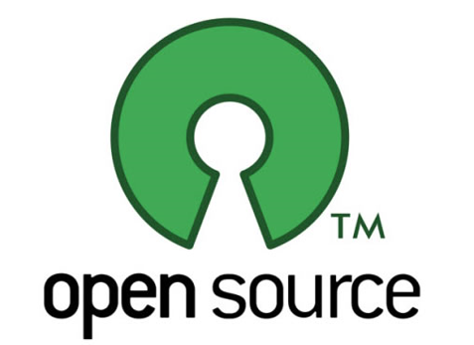
DevOps - Toolchain Focus
Presentation Tools
StarUML, Dia, etc.
Cloud Portal/Scripts
Dev Environments – Docker
Vagrant
Tuleap Open ALM, OrangeScrum, CakePHP, etc
Jenkins
Eclipse, Atom
VS CODE
R Studio
Xcode
GitHub
Gradle
Grunt
Open Build Server
Jenkins
Open Build Server
Eclipse, Atom
VS CODE
R Studio
Jenkins
Open Build Server
Eclipse, Atom
VS CODE
R Studio
Jenkins
Chef
Hudson
SaltStack
Jenkins
Nagios
Zabbix
Configure
Build
Monitor
Code
Test
Package
Release
Notes:
Microsoft OpenDev - https://azure.microsoft.com/en-us/opendev/

Slide 14
DevOps Focus for Advanced Analytics
Communication
Accounts and Plumbing
Shared Development
Data Flow – In and Out
Builds and Tests
Security
Notes:
Start with a view of the project to start the discussion - https://buckwoody.wordpress.com/2017/08/17/a-data-science-microsoft-project-template-you-can-use-in-your-solutions/
Account management is something that will often be new to the Data Science Team – https://docs.microsoft.com/en-us/azure/billing/billing-getting-started
Setting up the Azure Environment, particularly working with the Azure Resource Model and deployment slots, is important to consider at the outset – https://azure.microsoft.com/en-us/resources/videos/resource-group-model-modern-management-for-modern-cloud/
Development should break out of silos, so DevOps CI/CT/CD should be integrated early – https://docs.microsoft.com/en-us/aspnet/aspnet/overview/developing-apps-with-windows-azure/building-real-world-cloud-apps-with-windows-azure/continuous-integration-and-continuous-delivery
It’s important to consider the end-to-end experience, as this affects everything from security to design – https://gallery.cortanaintelligence.com/Tutorial/Create-an-End-to-End-E2E-Deployment-ready-Data-Pipeline-for-Consuming-Azure-Services-A-Step-by-Step-Guide-2
There is often an established Build/Test environment in the organization that may include CI/CT/CD – these need to be considered early (shift-left) – https://msdn.microsoft.com/en-us/library/dn449957.aspx
Data is important, and a full scrub for PII and other sensitivities are very important to the Data Science project - https://msdn.microsoft.com/en-us/magazine/ee291586.aspx

Slide 15
The Data Science/DevOps Difference
Communication
Microsoft Project, Flow
PowerPoint/ Visio, Azure Gallery
Visual Studio Online, Team Foundation Server
System Center
Azure Data Catalog
Configure
Notes:
Working in a team means “shifting left” – a new concept for many technologists - https://www.cio.com/article/3050579/leadership-management/want-agile-devops-shift-left.html

Slide 16
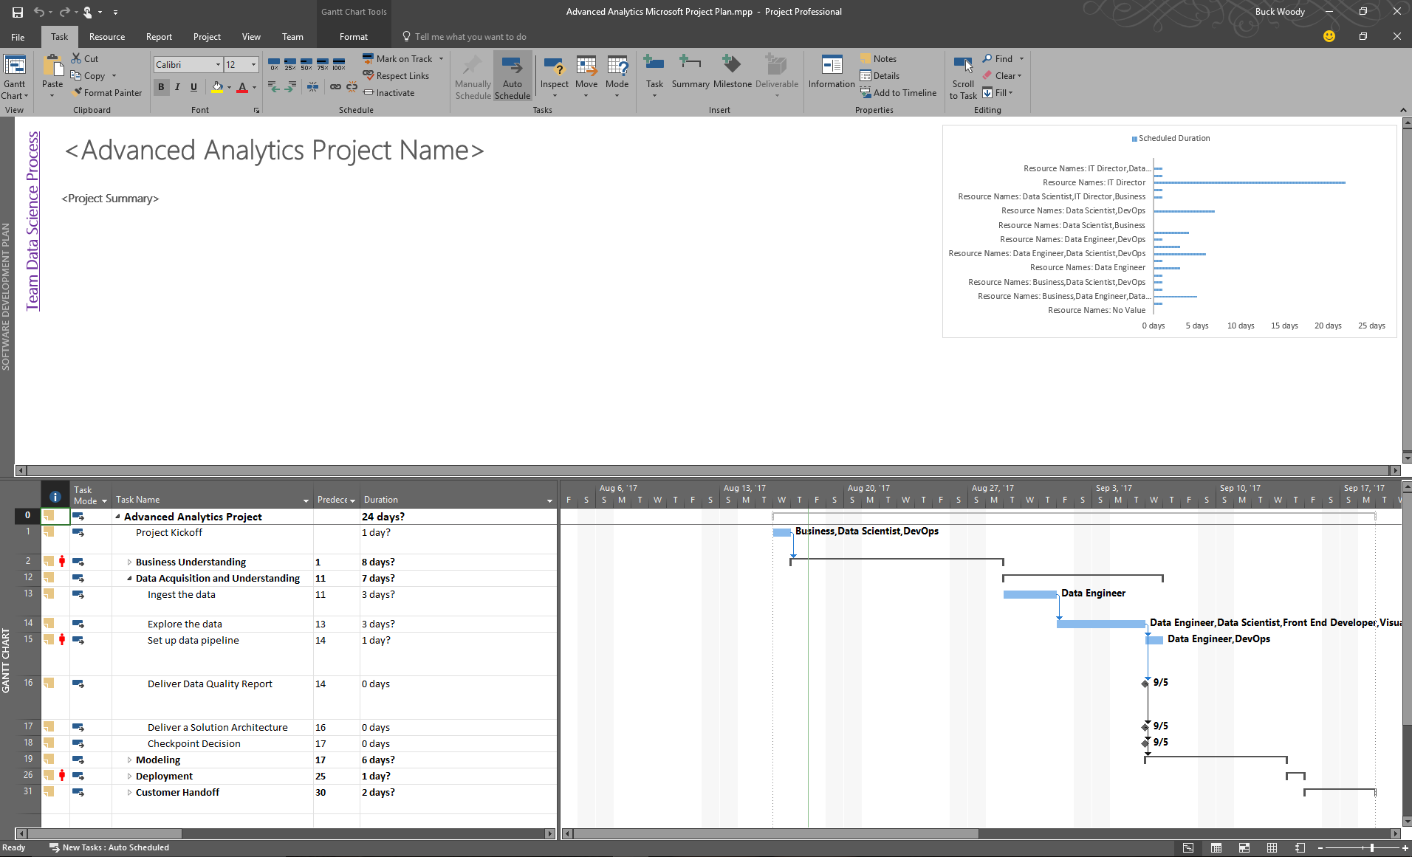
Participating in a Project Framework
Notes:
Working with Microsoft Project in Solutions: https://buckwoody.wordpress.com/2017/08/17/a-data-science-microsoft-project-template-you-can-use-in-your-solutions/
Synchronizing your TFS with MPS - https://www.visualstudio.com/en-us/docs/work/office/sync-ps-tfs

Slide 17


Architecture Design – Telling the Story
Determine the Question
Document the Data
Diagram the Data Flow
Notes:
PowerPoint, Visio, Whiteboard – choose a visualization declaration mechanism, make it part of your check in. Make sure you treat infrastructure and code as a single thought-entity. - https://www.visualstudio.com/en-us/docs/work/office/storyboard-your-ideas-using-powerpoint
Using a holistic approach: https://www.linkedin.com/pulse/architecture-data-exploration-using-microsoft-azure-verdon-mba
Planning a Big Data solution: https://msdn.microsoft.com/en-us/library/dn749858.aspx

Slide 18

Business Case
Wide World Importers is a company that imports and distributes products in multiple countries around the globe.
With several thousand employees, Information Technology is at the heart of our business operations, and has a significant cost.
Since we handle materials in multiple countries, we have a lot of private data, financial information, and other targets which have a high security profile. We are concerned with both external and internal attacks. In addition, many of our employees work in remote locations, some on ships and other challenging environments.
All of our IT systems have been modernized, and we’re taking in a significant amount of semi-structured data from computing devices – most of it real-time. After talking with our IT leadership, we need a way to determine anomalies within the data streams we get, and have a way to observe the anomalies in a dashboard so that we can respond to outages, threats, and changes quickly.
Notes:
More about Wide World Importers: https://docs.microsoft.com/en-us/sql/sample/world-wide-importers/overview
Anomaly Detection: https://gallery.cortanaintelligence.com/Solution/Anomaly-Detection-in-Real-time-Data-Streams

Slide 19

Design Statements
Wide World Importers is a company that imports and distributes products in multiple countries around the globe.
With several thousand employees, Information Technology is at the heart of our business operations, and has a significant cost.
Since we handle materials in multiple countries, we have a lot of private data, financial information, and other targets which have a high security profile. We are concerned with both external and internal attacks. In addition, many of our employees work in remote locations, some on ships and other challenging environments.
All of our IT systems have been modernized, and we’re taking in a significant amount of semi-structured data from computing devices – most of it real-time. After talking with our IT leadership, we need a way to determine anomalies within the data streams we get, and have a way to observe the anomalies in a dashboard so that we can respond to outages, threats, and changes quickly.
Notes:
More about Wide World Importers: https://docs.microsoft.com/en-us/sql/sample/world-wide-importers/overview
Anomaly Detection: https://gallery.cortanaintelligence.com/Solution/Anomaly-Detection-in-Real-time-Data-Streams

Slide 20
Decision Matrix
Decision | Technology | Elements | Rationale
Large amounts of semi-structured data | Azure Tables | Scale, KVP, Multi-access | Can be used by multiple technologies or queried
Fast, multiple sources of data | Event Hubs, Stream Analytics | Speed, complex processing | Fast Ingestion of massive datasets
Anomaly detection | Azure ML | API-Driven detection | Built-in algorithms, multi-dev
Reporting | SQL DB, Power BI | Ease of reporting, data visualization | Standard queries, action-based visualizations
System monitoring and management | Azure Data Factory, Application Insights | Actionable system metrics | OOB orchestration and reporting
Notes:
Another approach on decision matrices: http://www.businessnewsdaily.com/6146-decision-matrix.html

Slide 21
Document the Data - Azure Data Catalog
Register data sources
Tag the data
Document the data
Search and connect
Notes:
Full example: https://azure.microsoft.com/en-us/documentation/articles/data-catalog-get-started/

Slide 22
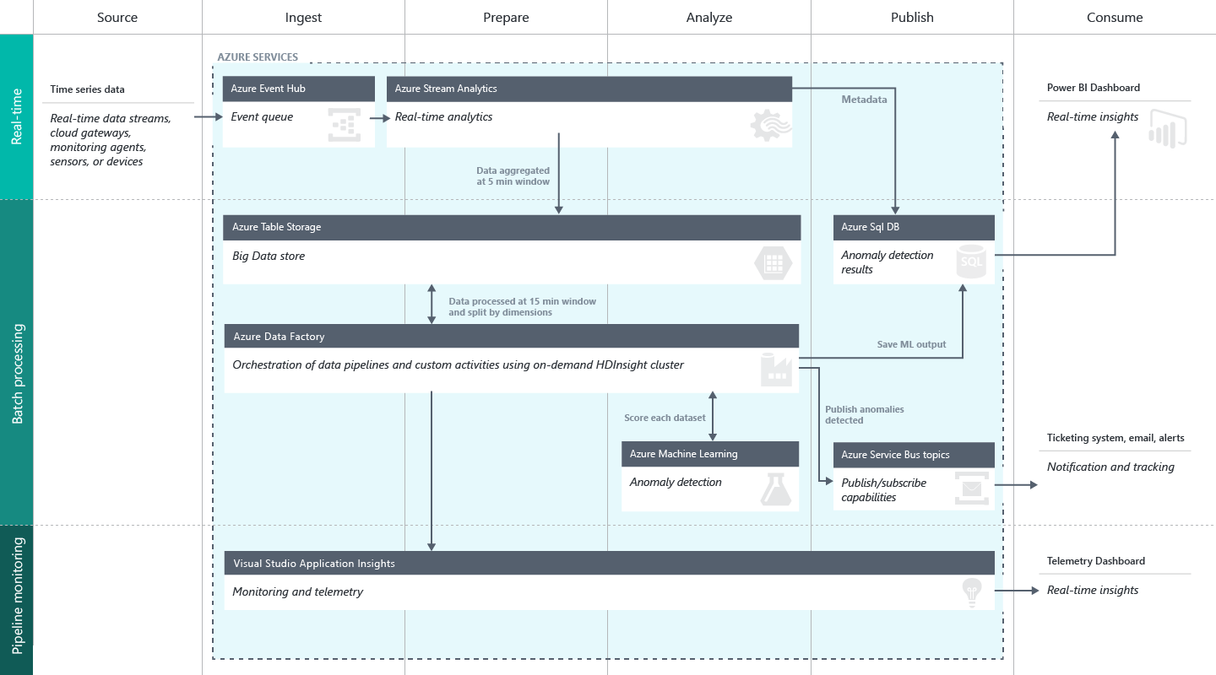
Create a Data Flow
Notes:
Full description is here: https://github.com/Azure/itanomalyinsights-cortana-intelligence-preconfigured-solution/blob/master/Docs/IT%20Anomaly%20Insights%20Post%20Deployment%20Instructions.md
Create your own Solution Templates: https://start.cortanaintelligence.com/CustomSolutions
More solution tutorials: https://gallery.cortanaintelligence.com/browse?categories=%5B%227%22%5D&skip=0&orderby=trending%20desc&tags=%5B%22Solution%22%5D

Slide 23
Lab:
Optional: Solution Design

Slide 24
The Data Science/DevOps Difference
Accounts and Plumbing
The Azure Portal
ARM, PowerShell, CLI
Visual Studio
System Center
Configure
Notes:
Understanding the Azure Portal for management and billing - https://azure.microsoft.com/en-us/account/

Slide 25
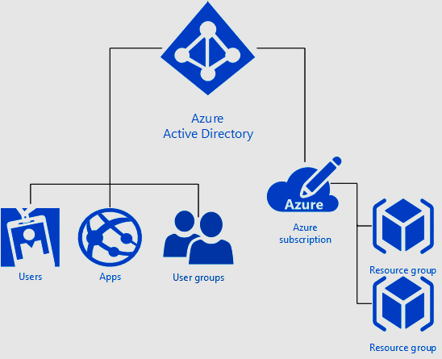
Accounts and Groups in the Microsoft Azure Portal
Notes:
Understanding the security waterfall - https://docs.microsoft.com/en-us/azure/active-directory/active-directory-understanding-resource-access
Main Portal Documentation - https://docs.microsoft.com/en-us/azure/azure-portal-overview
Role-Based Access control - https://docs.microsoft.com/en-us/azure/active-directory/role-based-access-control-what-is
DevOps with the Azure Portal - https://docs.microsoft.com/en-us/azure/azure-portal/tutorial-azureportal-devops

Slide 26
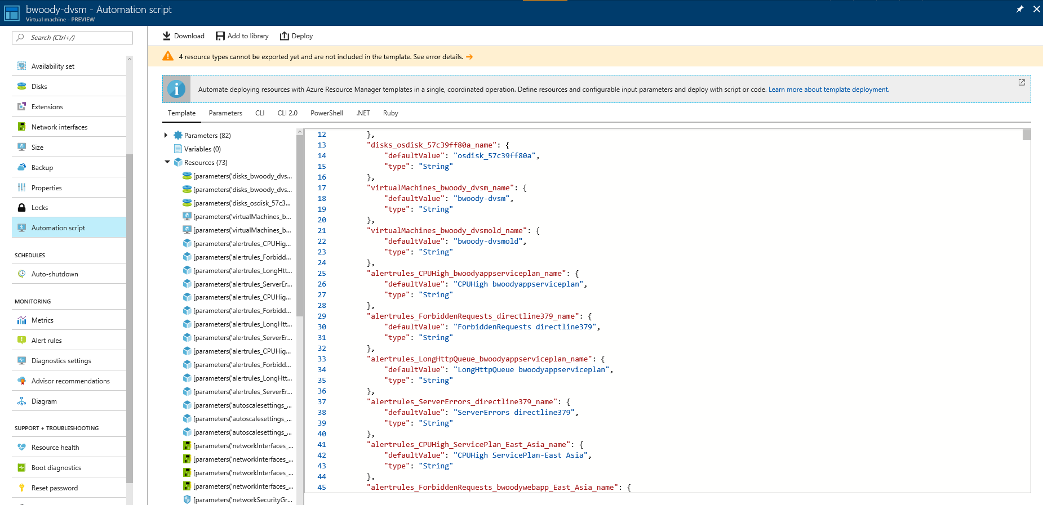
The Azure Resource Model
Notes:
Understanding the Azure Resource Model - https://docs.microsoft.com/en-us/azure/azure-resource-manager/resource-group-overview
Deploying resources with ARM Templates - https://docs.microsoft.com/en-us/azure/azure-resource-manager/resource-group-template-deploy
More on the DSC - http://channel9.msdn.com/Events/Ignite/2015/BRK3467

Slide 27
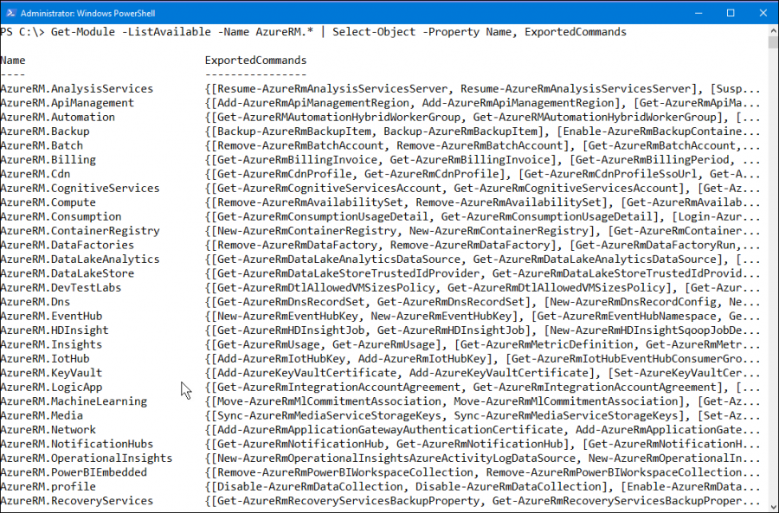
PowerShell and the CLI
Notes:
Getting Started with Microsoft Azure PowerShell - https://blogs.msdn.microsoft.com/mvpawardprogram/2017/08/22/microsoft-azure-powershell/

Slide 28
Lab:
Optional: Working with the Azure Resource Model

Slide 29
The Data Science/DevOps Difference
Shared Development
The DSVM and Containers
Visual Studio and Visual Studio Online / Team Foundation Server
“Codeless Coding”
Configure
Notes:
Working effectively in teams - https://www.svds.com/working-effectively-in-data-science-teams/

Slide 30
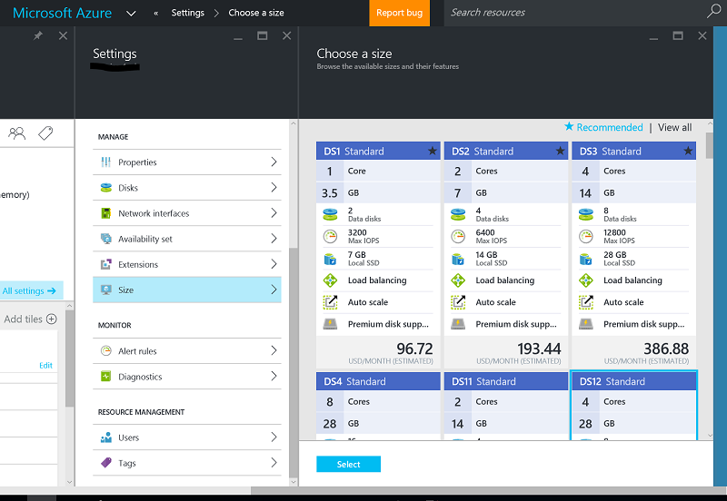
Development Environments
The Data Science Virtual Machine
Azure Containers
Notes:
Introduction to the DSVM - https://docs.microsoft.com/en-us/azure/machine-learning/machine-learning-data-science-virtual-machine-overview
Set up data science environments for use in the Team Data Science Process - https://docs.microsoft.com/en-us/azure/machine-learning/machine-learning-data-science-environment-setup
Working with Kubernetes or Docker Swarms: https://docs.microsoft.com/en-us/azure/container-service/
Create a CI/CD pipeline for containerized ASP.NET Core projects - https://blogs.msdn.microsoft.com/visualstudio/2017/08/22/create-a-cicd-pipeline-for-containerized-asp-net-core-projects/
Book on Azure Containers - https://blogs.msdn.microsoft.com/microsoft_press/2017/08/30/free-ebook-introduction-to-windows-containers/

Slide 31
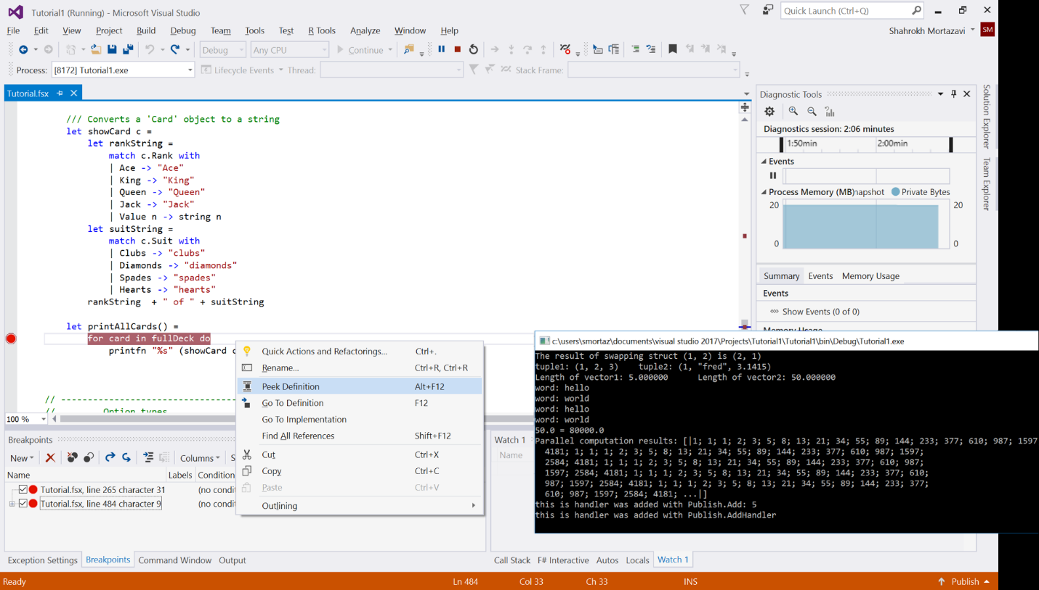
Visual Studio with VSO and TFS
R Tools for Visual Studio
Python Tools for Visual Studio
Azure Data Lake and Stream Analytics tools for Visual Studio (U-SQL Local Editor and Run)
Cosmos DB with Visual Studio
The Data Science Workload for VS2017
PowerShell tools for Visual Studio
Cloud Explorer for Visual
Azure Storage Add-in
HDInsight Tools for Visual Studio
Azure Data Factory with Visual Studio
SQL Data Warehouse with Visual Studio
Azure Analysis Services with Visual Studio
Notes:
Create a free account - https://go.microsoft.com/fwlink/?LinkId=307137&clcid=0x409
Head Documentation Page - https://www.visualstudio.com/en-us/docs/overview
DevOps references - https://www.visualstudio.com/en-us/docs/setup-admin/get-started
An end-to-end example of ci/cd: https://blogs.msdn.microsoft.com/uk_faculty_connection/2015/09/07/continuous-integration-and-testing-using-visual-studio-online/
An hour-long video of using Visual Studio and Visual Studio Online to move through an Agile workflow - https://tv.ssw.com/5642/project-management-with-visual-studio-online-dev-superpowers-episode-5
R Tools for Visual Studio – https://docs.microsoft.com/en-us/visualstudio/rtvs/
Python Tools for Visual Studio – https://docs.microsoft.com/en-us/visualstudio/python/python-in-visual-studio
Visual Studio 2017 - https://blogs.msdn.microsoft.com/visualstudio/2016/11/18/data-science-workloads-in-visual-studio-2017-rc/
PowerShell tools for Visual Studio - https://github.com/adamdriscoll/poshtools
Cloud Explorer for Visual Studio - https://docs.microsoft.com/en-us/azure/vs-azure-tools-resources-managing-with-cloud-explorer
Storage Tool Clients, including Visual Studio - https://docs.microsoft.com/en-us/azure/storage/common/storage-explorers
HDInsight Tools for Visual Studio - https://docs.microsoft.com/en-us/azure/hdinsight/hdinsight-hadoop-visual-studio-tools-get-started
Azure Data Lake and Stream Analytics tools for Visual Studio – https://www.microsoft.com/en-us/download/details.aspx?id=49504
U-SQL Local Editor and Run - https://channel9.msdn.com/series/azuredatalake/usql-localrun
Azure Data Factory with Visual Studio - https://docs.microsoft.com/en-us/azure/data-factory/data-factory-build-your-first-pipeline-using-vs
SQL Data Warehouse with Visual Studio - https://docs.microsoft.com/en-us/azure/sql-data-warehouse/sql-data-warehouse-query-visual-studio
Azure Analysis Services with Visual Studio - https://blogs.msdn.microsoft.com/analysisservices/2017/03/09/introducing-sql-server-data-tools-for-analysis-and-reporting-services-for-visual-studio-2017/
Cosmos DB with Visual Studio - https://docs.microsoft.com/en-us/azure/cosmos-db/create-table-dotnet

Slide 32
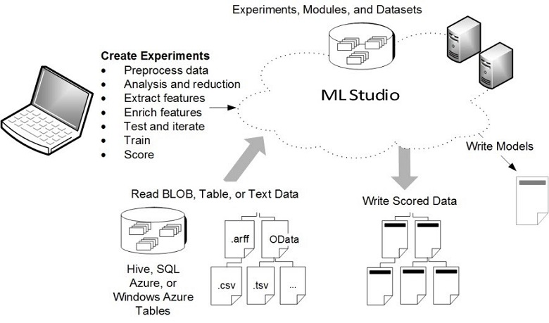
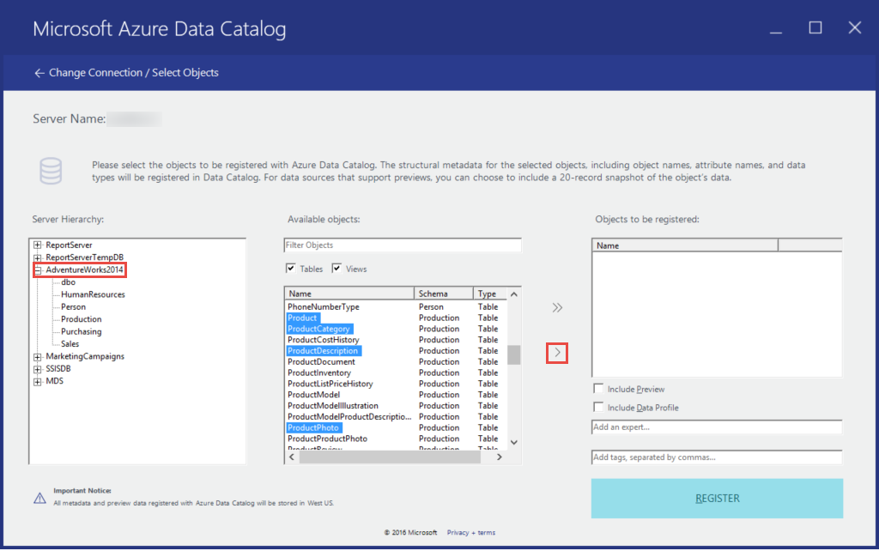
“Code-less Coding” Examples
Notes:
Overview, capabilities, and use - https://docs.microsoft.com/en-us/azure/machine-learning/machine-learning-what-is-ml-studio
Exporting the web service - https://docs.microsoft.com/en-us/powershell/module/azurerm.machinelearning/?view=azurermps-1.7.0
PowerShell for exporting - https://github.com/hning86/azuremlps

Slide 33
Lab:
Optional: Working with the Azure Data Catalog

Slide 34
The Data Science/DevOps Difference
Data Flow
The Azure Data Factory
ARM, PowerShell, CLI
Visual Studio with Visual Studio Online / Team Foundation Server
System Center
Configure
Notes:
Without a good data flow design, your project may not go into production - https://medium.com/towards-data-science/how-to-build-a-data-science-pipeline-f24341848045

Slide 35
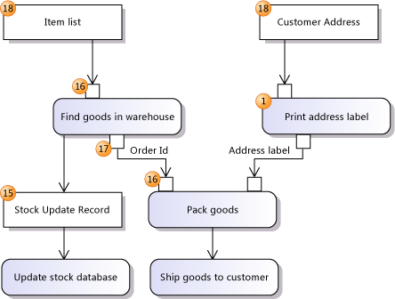
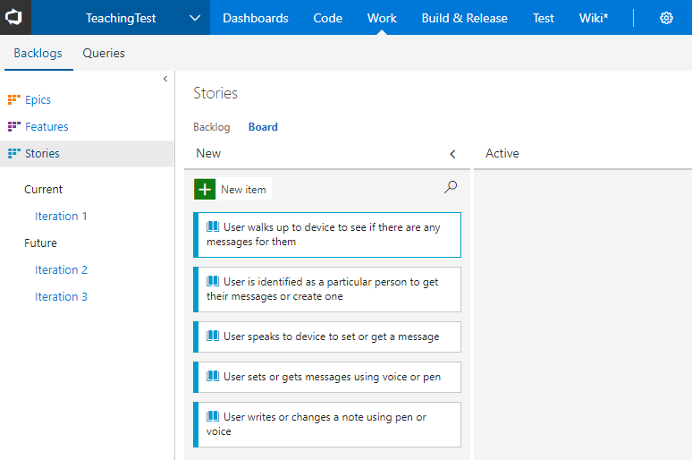
Visual Studio with VSO and TFS
Notes:
Analyze and Model your architecture in Visual Studio - https://msdn.microsoft.com/library/57b85fsc%28v=vs.140%29.aspx
Video – capture business workflows - http://channel9.msdn.com/posts/clinted/uml-with-vs-2010-part-4-capture-business-workflows/
Video – Improve architecture through modeling - http://go.microsoft.com/fwlink/?LinkID=252078
Creating your backlog - https://www.visualstudio.com/en-us/docs/work/backlogs/create-your-backlog

Slide 36
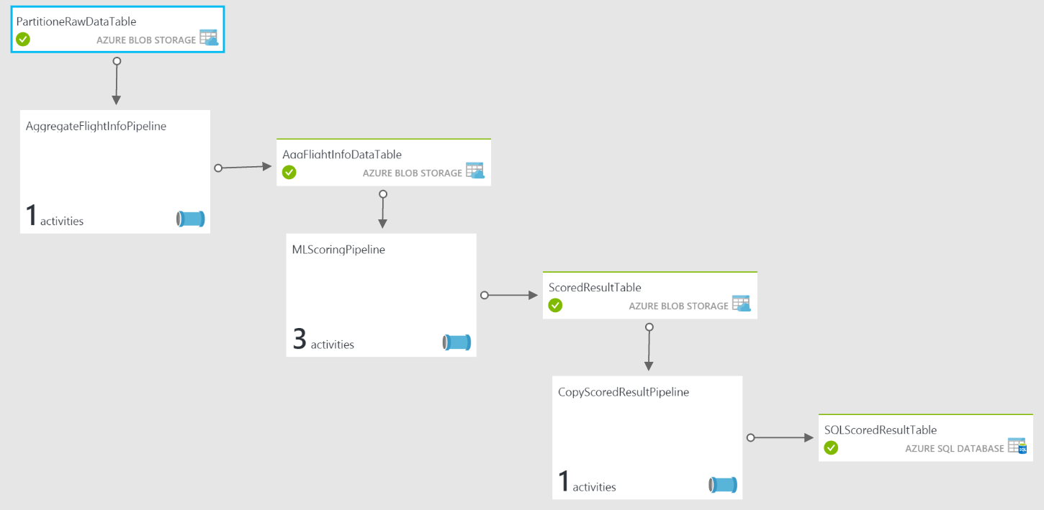
Azure Data Factory
Notes:
Understanding an ADF Pipeline with an example - https://docs.microsoft.com/en-us/azure/data-factory/data-factory-create-pipelines

Slide 37
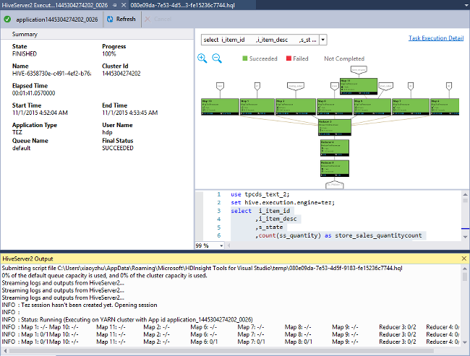
Visual Studio with Azure Tools
Notes:
Azure HDInsight Tools for Visual Studio - https://docs.microsoft.com/en-us/azure/hdinsight/hdinsight-hadoop-visual-studio-tools-get-started
Azure Data Lake Tools for Visual Studio - https://docs.microsoft.com/en-us/azure/data-lake-analytics/data-lake-analytics-data-lake-tools-get-started

Slide 38
The Data Science/DevOps Difference
Build and Test
The Azure Deployment Service
ARM, DSC
Visual Studio and Visual Studio Online, Team Foundation Server
System Center
Azure Data Factory
Build, Test, Package
Notes:
Assets within a Data Science project may contain multiple artifacts. For the most part, an Azure Resource Manager template can contain most of these - https://docs.microsoft.com/en-us/azure/azure-resource-manager/resource-group-template-deploy-portal

Slide 39
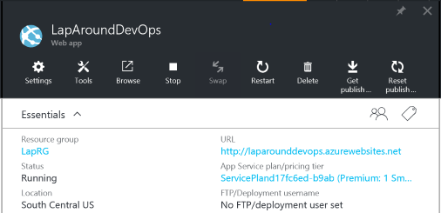
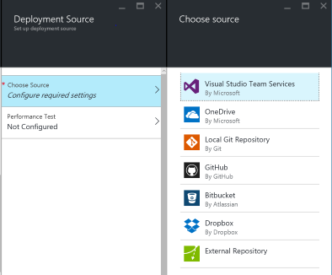
The Microsoft Azure Portal
Notes:
Main Portal Documentation - https://docs.microsoft.com/en-us/azure/azure-portal-overview
DevOps with the Azure Portal - https://docs.microsoft.com/en-us/azure/azure-portal/tutorial-azureportal-devops

Slide 40
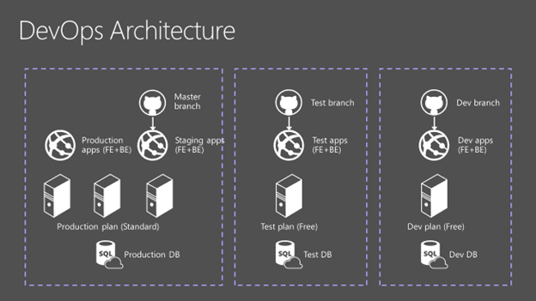
Azure Deployment Service
Notes:
Main reference - https://docs.microsoft.com/en-us/azure/app-service/app-service-deployment-readme
Reference architecture - https://docs.microsoft.com/en-us/azure/app-service-web/app-service-agile-software-development

Slide 41
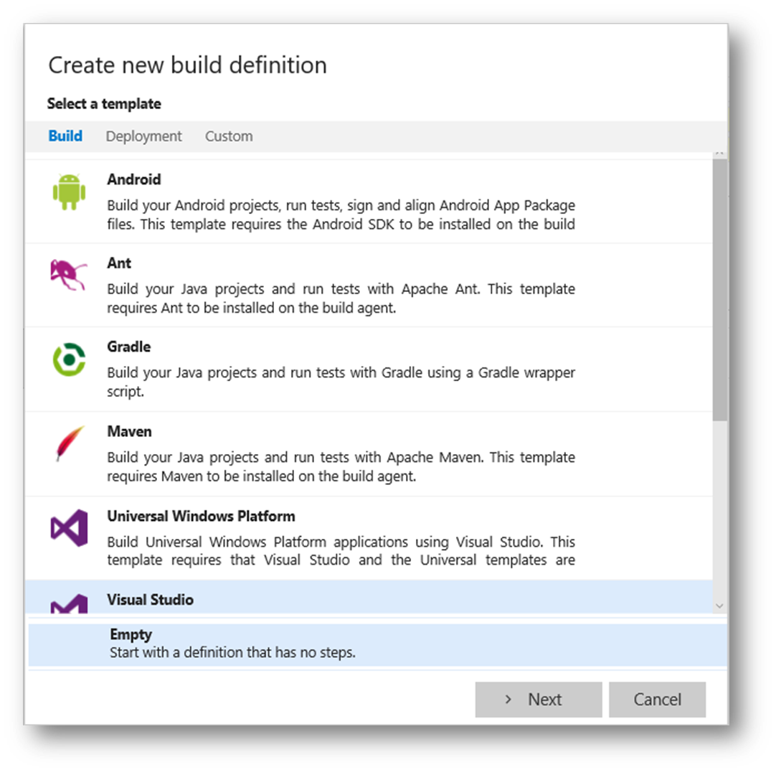
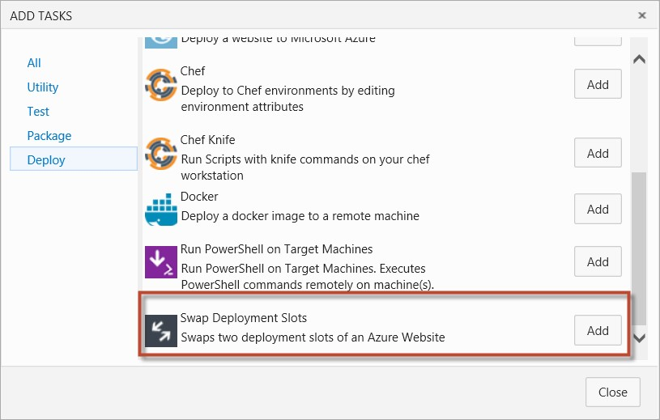
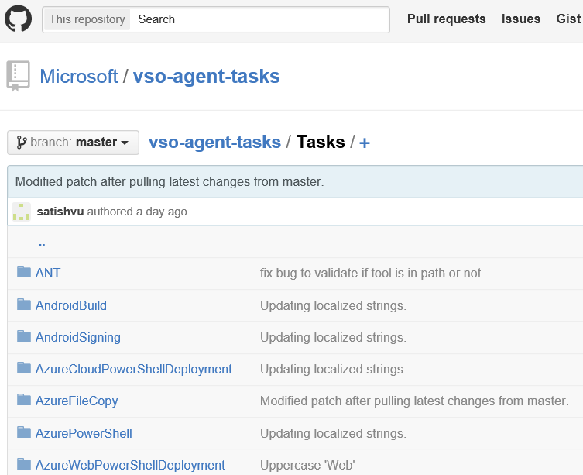
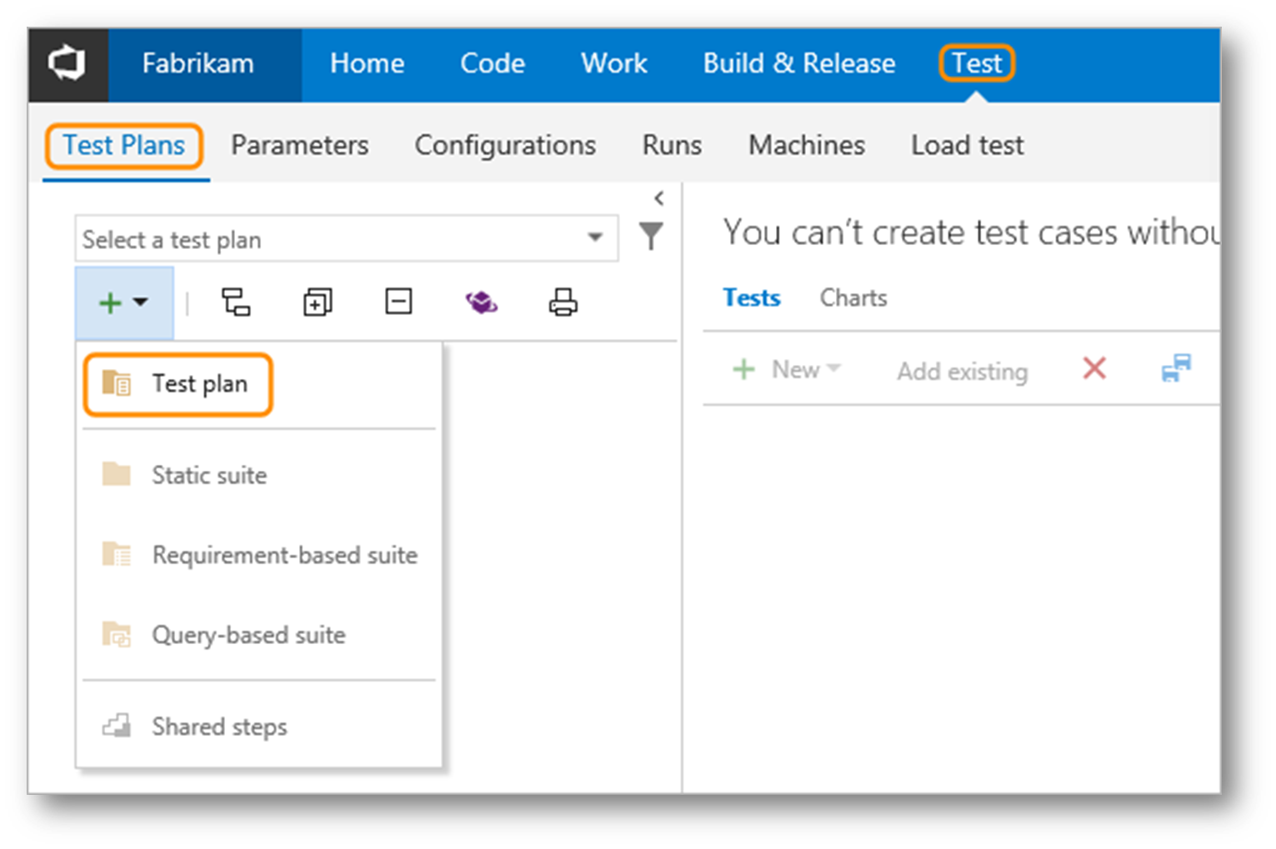
Custom Build Tasks
Visual Studio with VSO and TFS
Notes:
Understanding TFS/VSO builds - https://msdn.microsoft.com/en-us/library/ms181709(v=vs.90).aspx

Slide 42
VSO - Service hooks
Events: build completed, code checked in, work item changed, pull request, and more.
Services: AppVeyor, Campfire, Flowdock, HipChat, Jenkins, Kato, MyGet, Slack, Trello, UserVoice, Zendesk, Zapier, and more…
Send notifications or perform actions on external services when events happens in your project
Supports popular services like Slack and Trello out-the-box
Avoids delays typically seen with polling
Notes:
Integrating with Service Hooks - https://www.visualstudio.com/get-started/integrate/integrating-with-service-hooks-vs

Slide 43
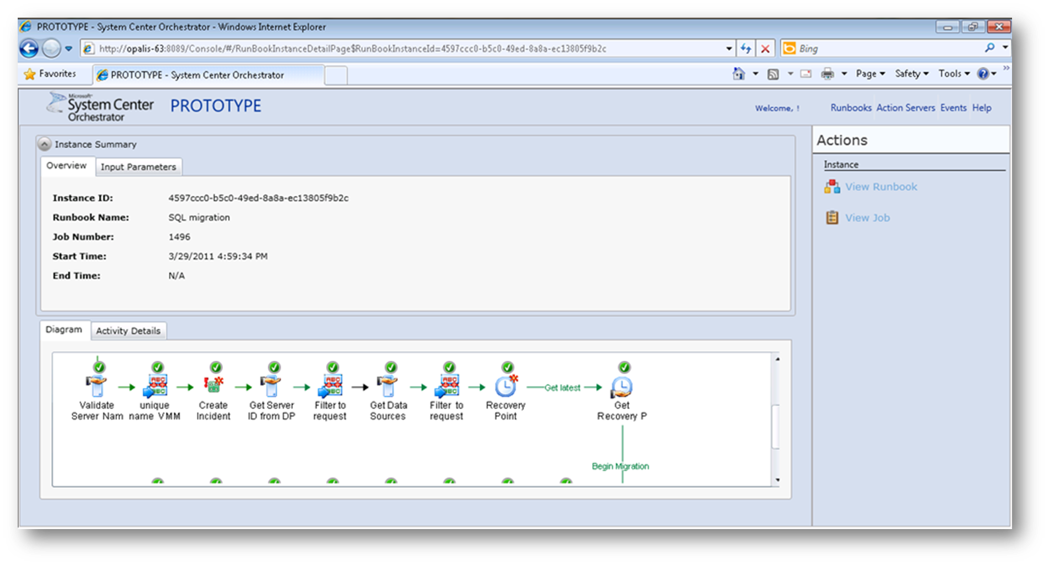
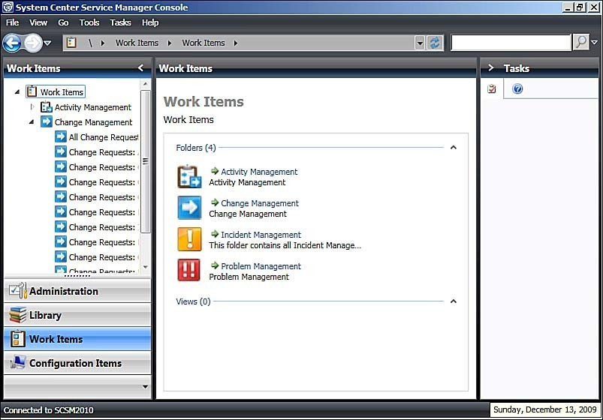
System Center
Notes:
Using System Center Runbooks - https://technet.microsoft.com/en-us/library/hh403791(v=sc.12).aspx

Slide 44
Lab:
Optional: Data Flow

Slide 45
The Data Science/DevOps Difference
Security
Azure Trust Center
The Azure Portal
ARM, PowerShell, CLI
Visual Studio
System Center
Threat Modeling Tool
Attack Surface Analyzer
Build, Test, Monitoring
Notes:
The Azure Trust Center (Security, Privacy, Transparency, Compliance) - https://azure.microsoft.com/en-us/support/trust-center/
Working with the Azure Key Vault - https://blogs.msdn.microsoft.com/troy_aults_blog/2017/08/29/utilizing-key-vault-to-create-credentials-for-automation/

Slide 46
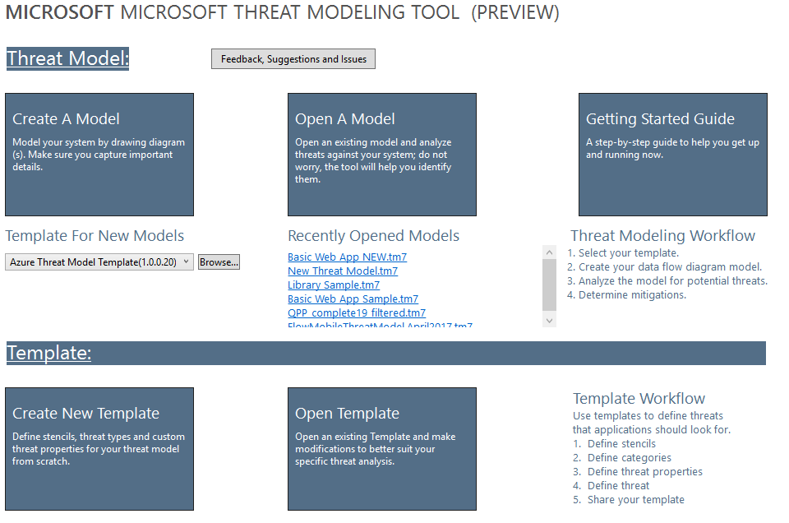
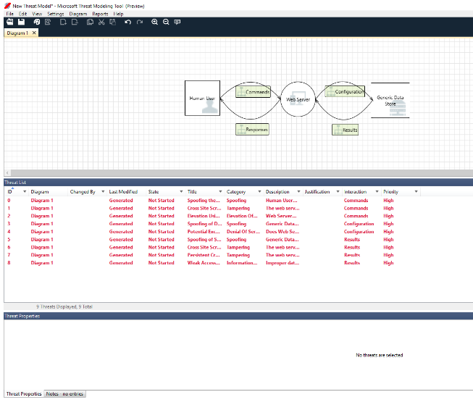
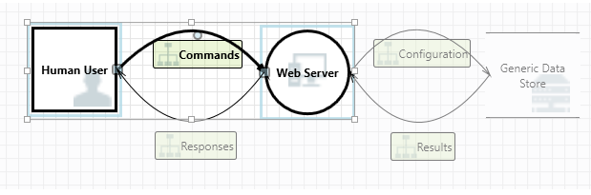
The Microsoft Threat Modeling Tool
Notes:
Uses the STRIDE methodology - (Spoofing, Tampering, Info Disclosure, Denial of Service and Elevation of Privilege) - https://en.wikipedia.org/wiki/STRIDE_(security)
The Threat Modeling Tool and the SDL - https://docs.microsoft.com/en-us/azure/security/azure-security-threat-modeling-tool
The Microsoft Threat Modeling Tool download - https://www.microsoft.com/en-us/download/details.aspx?id=49168

Slide 47
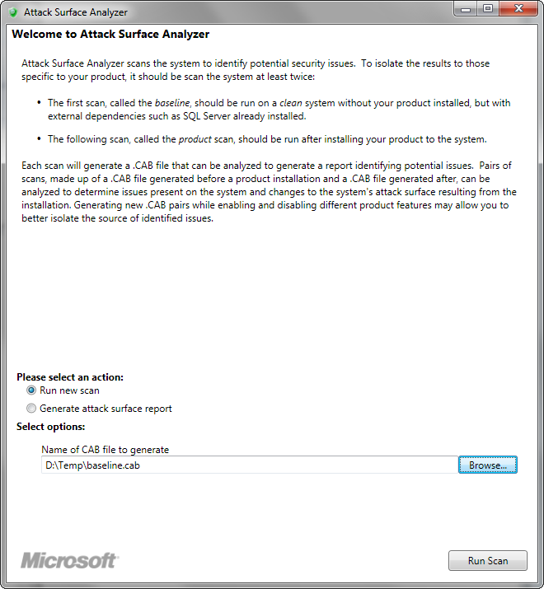
The Microsoft Attack Surface Analyzer
Notes:
This tool helps to ensure you keep Windows secure, checking your app to make sure it does not introduce new vulnerabilities - https://technet.microsoft.com/en-us/security/gg749821.aspx

Slide 48
Lab:
Optional: The Microsoft Threat Analyzer

Slide 49
The Data Science/DevOps Difference
Y Mucho Mas
Monitoring
Continuous Integration, Testing, Development
All
Notes:
There is a great deal more information and many other tools to learn – all depend on your implementation

Slide 50
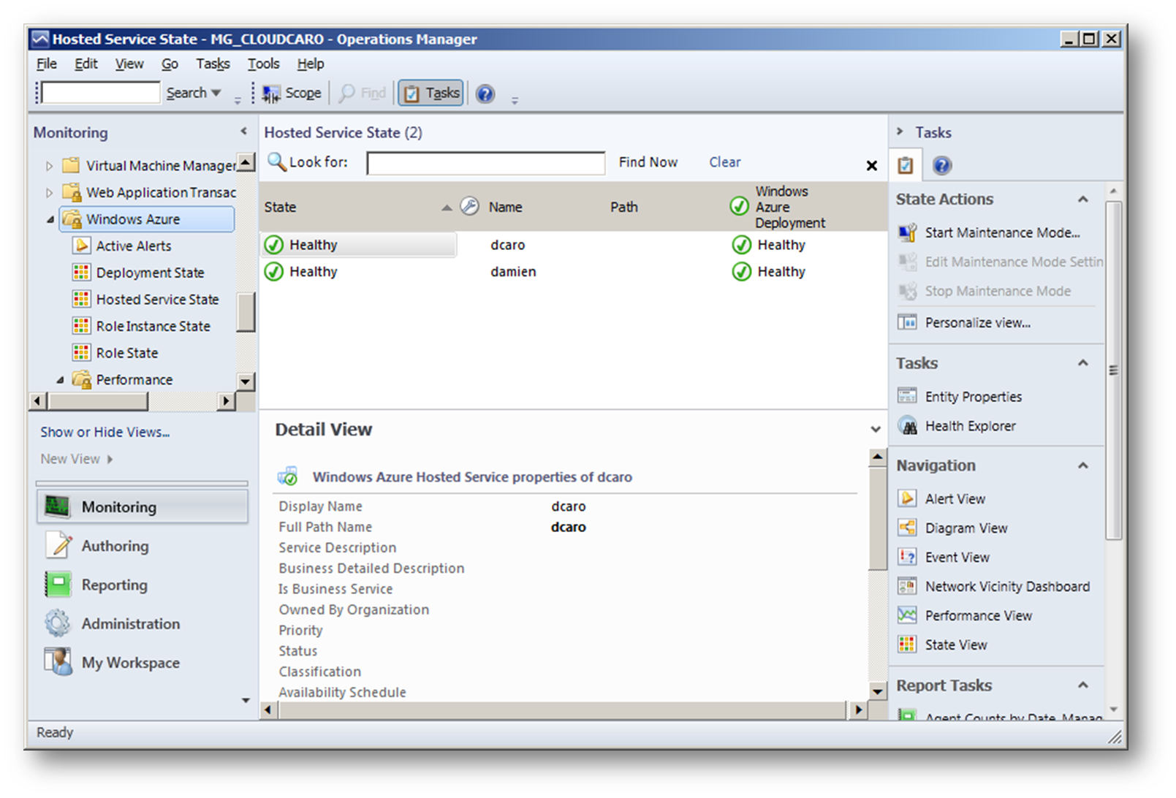
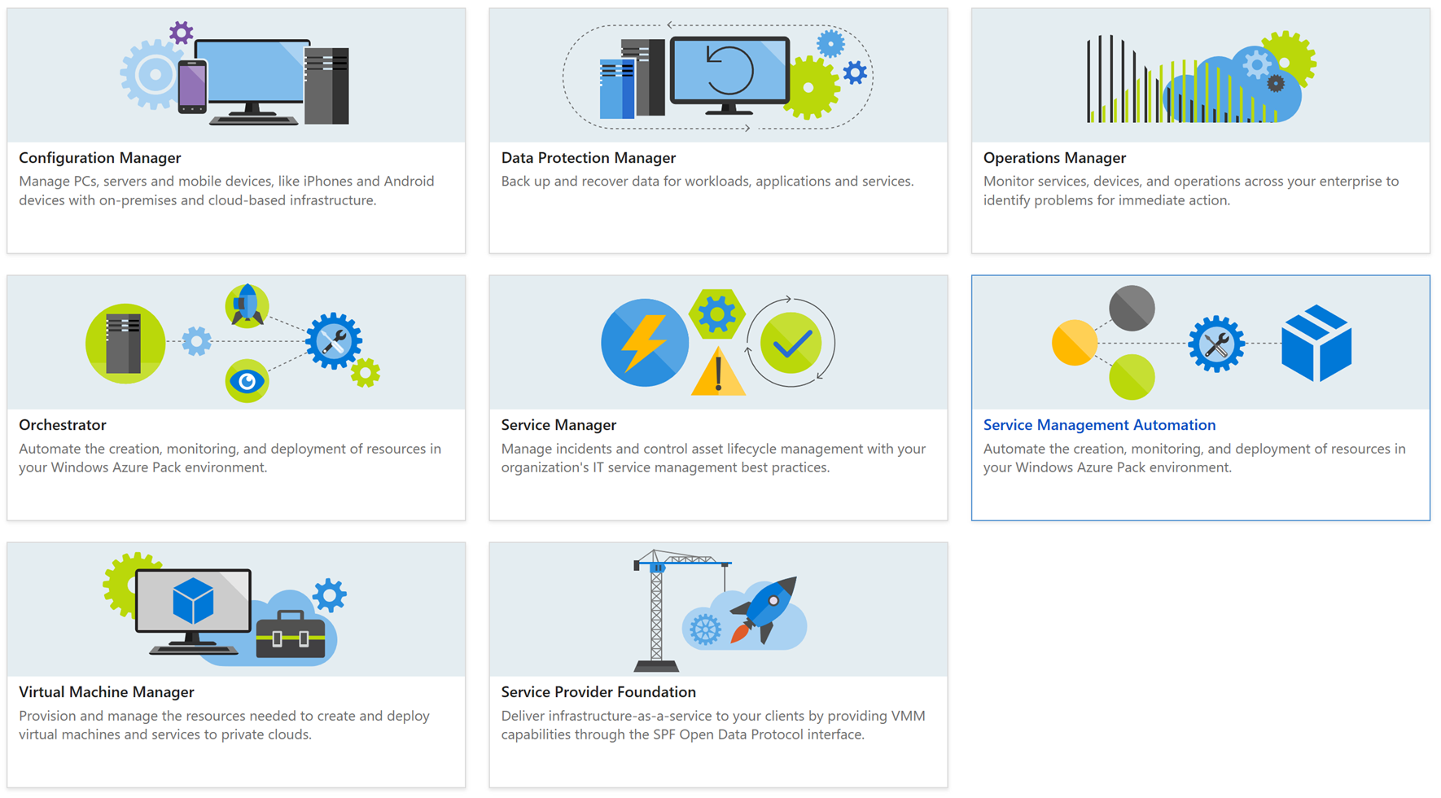
Monitoring – and More – with System Center
Notes:
Many organizations have implemented System Center. This system can be integrated with “Packs” - https://docs.microsoft.com/en-us/system-center/orchestrator/windows-azure-integration-pack

Slide 51

Monitoring with Application Insights
Application Insights
Notes:
Overview: https://docs.microsoft.com/en-us/azure/application-insights/app-insights-overview

Slide 52
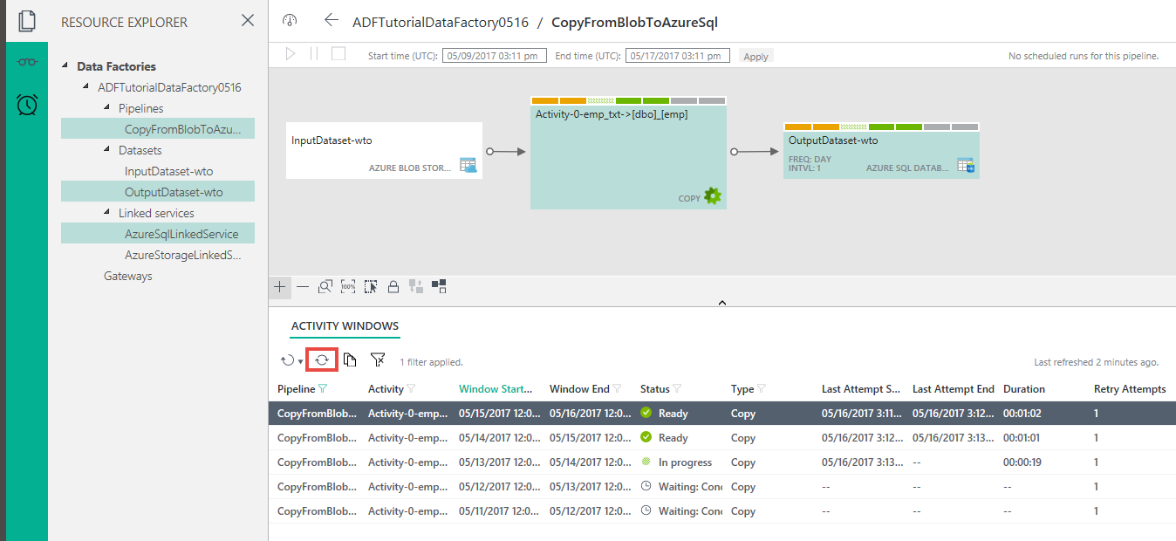
Monitoring – and More - with the Azure Data Factory
Notes:
There is also a full app for monitoring ADF along with the Azure Portal - https://docs.microsoft.com/en-us/azure/data-factory/data-factory-monitor-manage-app

Slide 53
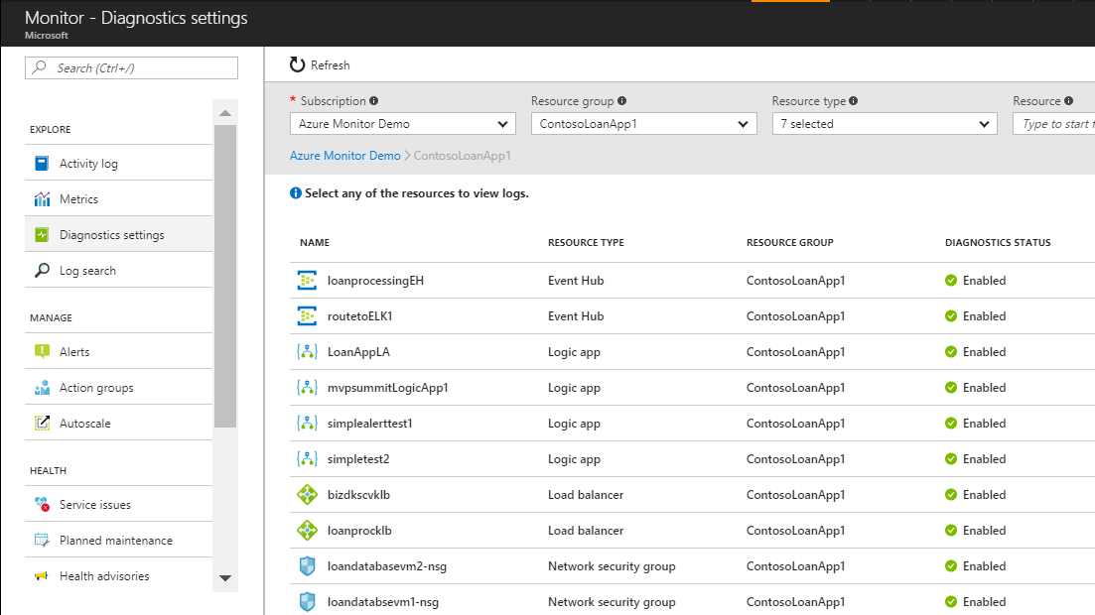
Swiss-Army Knife - Log Scrubbing
Notes:
Using Azure Monitor - https://azure.microsoft.com/en-us/blog/azure-monitor-multiple-diagnostic-settings/
And there are multiple other options - https://blogs.msdn.microsoft.com/azureedu/2017/10/13/monitoring-azure-resources-tools-and-technology/

Slide 54
Lab:
Optional: Working with Logs

Slide 55
Resources for DevOps Practices
Optimize your DevOps practices and tools:
Get started on your DevOps journey: aka.ms/devops
Download the Forrester Infrastructure-as-Code whitepaper:
Complexity kills. Automate with Infra as code: aka.ms/iac_tlp
Technical resources for Practitioners:
Get access to free online training, evals and HOLs: aka.ms/devopsmva
Watch DevOps episodes of the Edge Show
Get current DevOps news and technical demos from engineering: http://aka.ms/edgedevops
Join the Community conversations:
Use #TalkDevOps on Twitter

Slide 56

BuckWoody.Wordpress.Com

